Slide 1

Northwest Louisiana ECONOMIC DASHBOARD
April, 2026
Center for Business and Economic Research Louisiana State University Shreveport
cber@lsus.edu

Slide 2
Goals of the Dashboard
Goals:
The Northwest Louisiana Economic Dashboard has the following goals:
Visualize a set of economic indices based on sound and credible data.
Act as a reference for people interested in making investments in Northwest Louisiana.
Index:
The content of this presentation is the following:
Tax Collection
Housing
Building Permits
Unemployment
Casino Revenue and Admission
Airport Traffic
Mortgage Rates, Inflation, Natural Gas, Oil, and Gasoline Prices
NWLA – ECONOMIC DASHBOARD
Goals and Index

Slide 3
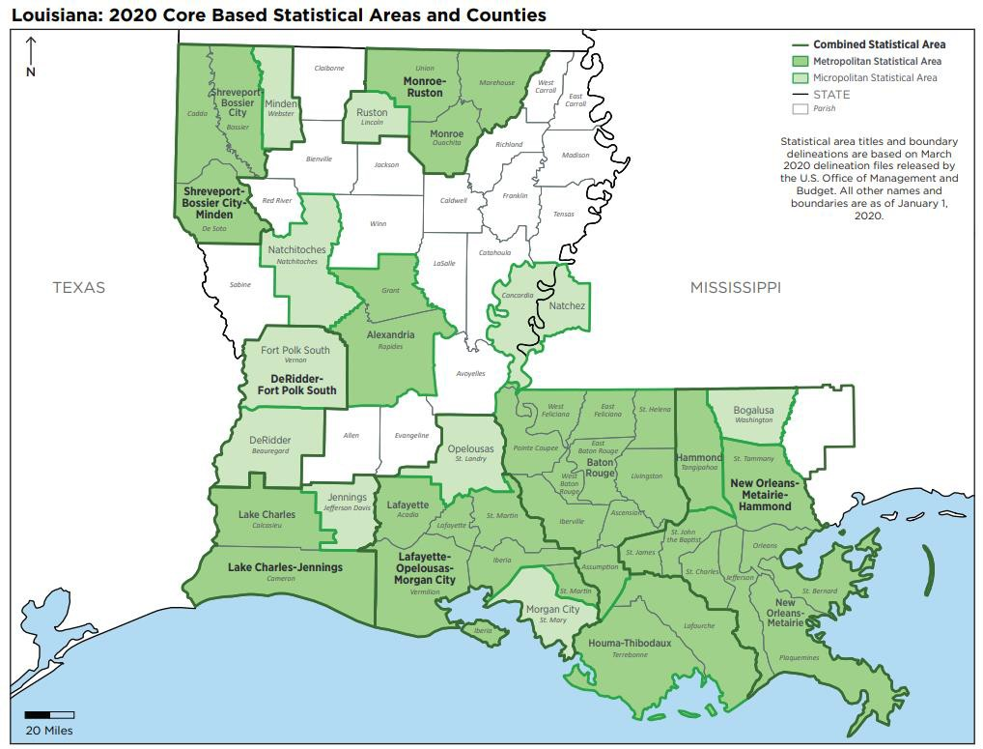
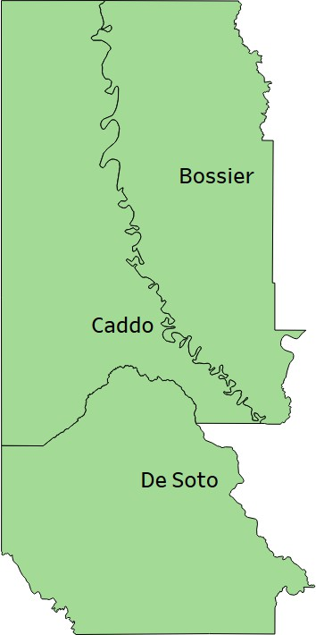
NWLA
Northwest Louisiana - Shreveport-Bossier City-Minden Core Based Statistical Area
Shreveport-Bossier City MSA Area
From: U.S. Census Bureau, Population Division
NWLA – ECONOMIC DASHBOARD
Geographic Reference

Slide 4
Key Findings

Slide 5
Tax Collection, Housing, and Building Permits
Tax Collection:
The City of Shreveport collected $41,413,718 in taxes in first quarter 2026. This was a 2.0% increase over 2025.
Housing:
The housing market in the Shreveport-Bossier CBSA has remained resilient with the current high interest rates. The median listing price was $246,175 at the end of the first quarter of 2026. The median listing price was $250,000 at the end of the first quarter 2025 and $242,500 at the end of the first quarter 2024. The median listing price in Bossier Parish for March is $318,175 and the median listing price in Caddo Parish for March is $198,500. Both are near their median listing price March 2025.
Building Permits:
Due to the government shutdown, we are missing February and March data, and therefore, are unable to summarize the first quarter data. We will update the data visualization on our webpage when this data becomes available. We did see a 4.8% increase in the number and a 5.1% increase in the value of building permits for 2025.
NWLA – ECONOMIC DASHBOARD
Key Findings

Slide 6
Unemployment and Casino Revenue/Admissions
Unemployment:
The unemployment rate in Shreveport-Bossier City MSA, Bossier Parish, and Caddo Parish in February* was 4.5%, 4.1%, and 4.6%, respectively. These numbers are consistent with the current trend. The MSA’s labor force has grown by almost 7,000 people since January of 2025.
*Due to the Government shutdown, reporting has been delayed. Instead of waiting another month for March data, we are reporting the currently available data.
Casino Revenue and Admissions:
Casino revenues were up again in the first quarter of 2026 compared to 2025. They brought in a combined $156,849,705 in revenue which is 3.7% higher than first quarter 2025.
NWLA – ECONOMIC DASHBOARD
Key Findings

Slide 7
Airport Traffic, Mortgage Rates, Inflation, and Gas Prices
Airport Traffic:
After a historic 2025, the airport saw a strong first quarter. While the number of travelers in first quarter 2026 was below first quarter 2025, it was the second largest first quarter posted by the airport with over 155,000 people using the airport.
Mortgage Rates, Inflation, & Gas Prices:
Average 30-year mortgage rates averaged 6.11% in the first quarter of 2026. This is down from 6.83% in the first quarter of 2025 and is the lowest it has been since the first quarter of 2023.
Natural gas prices ended the quarter at $4.71. This is an increase compared to the first quarter of 2024 ($2.15) and the first quarter of 2025 ($4.14). Crude oil ended the quarter at $72.74. It was $71.78 in first quarter 2025.
NWLA – ECONOMIC DASHBOARD
Key Findings

Slide 8
Tax Collection

Slide 9
Tax Collection – City of Shreveport
Year-Quarter | Tax Collection | Year-Quarter | Tax Collection | % Change
2023-1 | $40,745,957 | 2022-1 | $38,754,691 | 5.1%
2023-2 | $41,158,821 | 2022-2 | $39,816,123 | 3.4%
2023-3 | $42,117,159 | 2022-3 | $39,475,515 | 6.7%
2023-4 | $39,557,727 | 2022-4 | $38,700,434 | 2.2%
2024-1 | $40,503,396 | 2023-1 | $40,745,957 | -0.6%
2024-2 | $40,450,162 | 2023-2 | $41,158,821 | -1.7%
2024-3 | $40,939,508 | 2023-3 | $42,117,159 | -2.8%
2024-4 | $40,984,246 | 2023-4 | $39,557,727 | 3.6%
2025-1 | $40,619,448 | 2024-1 | $40,503,396 | 0.3%
2025-2 | $42,470,898 | 2024-2 | $40,450,162 | 5.0%
2025-3 | $41,918,363 | 2024-3 | $40,939,508 | 2.4%
2025-4 | $41,544,037 | 2024-4 | $40,984,246 | 1.4%
2026-1 | $41,413,718 | 2025-1 | $40,619,448 | 2.0%
Data from: City of Shreveport
NWLA – ECONOMIC DASHBOARD
Tax Collection

Slide 10
Tax Collection – Town of Vivian
Year-Quarter | Tax Collection | Year-Quarter | Tax Collection | % Change
2023-1 | $411,084 | 2022-1 | $353,688 | 16.2%
2023-2 | $434,316 | 2022-2 | $402,962 | 7.8%
2023-3 | $464,427 | 2022-3 | $372,213 | 24.8%
2023-4 | $444,490 | 2022-4 | $402,790 | 10.4%
2024-1 | $425,651 | 2023-1 | $411,084 | 3.5%
2024-2 | $423,149 | 2023-2 | $434,316 | -2.6%
2024-3 | $384,884 | 2023-3 | $464,427 | -17.1%
2024-4 | $378,819 | 2023-4 | $444,490 | -14.8%
2025-1 | $419,093 | 2024-1 | $425,651 | -1.5%
2025-2 | $426,323 | 2024-2 | $423,149 | 0.8%
2025-3 | $417,357 | 2024-3 | $384,884 | 8.4%
2025-4 | $446,139 | 2024-4 | $378,819 | 17.8%
2026-1 | $407,420 | 2025-1 | $419,093 | -2.8%
Data from: City of Shreveport
NWLA – ECONOMIC DASHBOARD
Tax Collection

Slide 11
Tax Collection – Town of Oil City
Year-Quarter | Tax Collection | Year-Quarter | Tax Collection | % Change
2023-1 | $80,569 | 2022-1 | $60,923 | 32.2%
2023-2 | $86,264 | 2022-2 | $77,580 | 11.2%
2023-3 | $70,052 | 2022-3 | $84,790 | -17.4%
2023-4 | $55,357 | 2022-4 | $88,825 | -37.7%
2024-1 | $44,942 | 2023-1 | $80,569 | -44.2%
2024-2 | $48,473 | 2023-2 | $86,264 | -43.8%
2024-3 | $51,647 | 2023-3 | $70,052 | -26.3%
2024-4 | $56,049 | 2023-4 | $55,357 | 1.2%
2025-1 | $49,342 | 2024-1 | $44,942 | 9.8%
2025-2 | $49,005 | 2024-2 | $48,473 | 1.1%
2025-3 | $56,797 | 2024-3 | $51,647 | 10.0%
2025-4 | $36,350 | 2024-4 | $56,049 | -35.1%
2026-1 | $43,050 | 2025-1 | $49,342 | -12.8%
Data from: City of Shreveport
NWLA – ECONOMIC DASHBOARD
Tax Collection

Slide 12
Tax Collection – Town of Mooringsport
Year-Quarter | Tax Collection | Year-Quarter | Tax Collection | % Change
2023-1 | $22,246 | 2022-1 | $17,899 | 24.3%
2023-2 | $27,602 | 2022-2 | $18,504 | 49.2%
2023-3 | $29,864 | 2022-3 | $21,271 | 40.4%
2023-4 | $19,040 | 2022-4 | $18,564 | 2.6%
2024-1 | $20,051 | 2023-1 | $22,246 | -9.9%
2024-2 | $21,931 | 2023-2 | $27,602 | -20.5%
2024-3 | $22,366 | 2023-3 | $29,864 | -25.1%
2024-4 | $23,657 | 2023-4 | $19,040 | 24.2%
2025-1 | $25,976 | 2024-1 | $20,051 | 29.5%
2025-2 | $23,470 | 2024-2 | $21,931 | 7.0%
2025-3 | $29,051 | 2024-3 | $22,366 | 29.9%
2025-4 | $27,925 | 2024-4 | $23,657 | 18.0%
2026-1 | $28,585 | 2025-1 | $25,976 | 10.0%
Data from: City of Shreveport
NWLA – ECONOMIC DASHBOARD
Tax Collection

Slide 13
Tax Collection – Town of Greenwood
Year-Quarter | Tax Collection | Year-Quarter | Tax Collection | % Change
2023-1 | $262,349 | 2022-1 | $207,430 | 26.5%
2023-2 | $291,044 | 2022-2 | $272,861 | 6.7%
2023-3 | $241,080 | 2022-3 | $270,956 | -11.0%
2023-4 | $214,374 | 2022-4 | $273,285 | -21.6%
2024-1 | $214,276 | 2023-1 | $262,349 | -18.3%
2024-2 | $197,374 | 2023-2 | $291,044 | -32.2%
2024-3 | $212,905 | 2023-3 | $241,080 | -11.7%
2024-4 | $183,741 | 2023-4 | $214,374 | -14.3%
2025-1 | $203,395 | 2024-1 | $214,276 | -5.1%
2025-2 | $223,612 | 2024-2 | $197,374 | 13.3%
2025-3 | $212,519 | 2024-3 | $212,905 | -0.2%
2025-4 | $217,088 | 2024-4 | $183,741 | 18.1%
2026-1 | $219,497 | 2025-1 | $203,395 | 7.9%
Data from: City of Shreveport
NWLA – ECONOMIC DASHBOARD
Tax Collection

Slide 14
Tax Collection – Town of Rodessa
Year-Quarter | Tax Collection | Year-Quarter | Tax Collection | % Change
2023-1 | $3,718 | 2022-1 | $4,546 | -18.2%
2023-2 | $6,777 | 2022-2 | $4,906 | 38.1%
2023-3 | $4,475 | 2022-3 | $3,952 | 13.2%
2023-4 | $4,770 | 2022-4 | $5,029 | -5.2%
2024-1 | $4,498 | 2023-1 | $3,718 | 21.0%
2024-2 | $3,329 | 2023-2 | $6,777 | -50.9%
2024-3 | $3,847 | 2023-3 | $4,475 | -14.0%
2024-4 | $6,285 | 2023-4 | $4,770 | 31.8%
2025-1 | $3,310 | 2024-1 | $4,498 | -26.4%
2025-2 | $5,388 | 2024-2 | $3,329 | 61.8%
2025-3 | $7,926 | 2024-3 | $3,847 | 106.1%
2025-4 | $7,452 | 2024-4 | $6,285 | 18.6%
2026-1 | $7,071 | 2025-1 | $3,310 | 113.6%
Data from: City of Shreveport
NWLA – ECONOMIC DASHBOARD
Tax Collection

Slide 15
Tax Collection – Town of Blanchard
Year-Quarter | Tax Collection | Year-Quarter | Tax Collection | % Change
2023-1 | $162,657 | 2022-1 | $129,978 | 25.1%
2023-2 | $185,397 | 2022-2 | $136,389 | 35.9%
2023-3 | $204,065 | 2022-3 | $153,884 | 32.6%
2023-4 | $191,930 | 2022-4 | $157,092 | 22.2%
2024-1 | $195,444 | 2023-1 | $162,657 | 20.2%
2024-2 | $188,653 | 2023-2 | $185,397 | 1.8%
2024-3 | $210,326 | 2023-3 | $204,065 | 3.1%
2024-4 | $207,196 | 2023-4 | $191,930 | 8.0%
2025-1 | $190,284 | 2024-1 | $195,444 | -2.6%
2025-2 | $226,014 | 2024-2 | $188,653 | 19.8%
2025-3 | $213,629 | 2024-3 | $210,326 | 1.6%
2025-4 | $203,816 | 2024-4 | $207,196 | -1.6%
2026-1 | $200,942 | 2025-1 | $190,284 | 5.6%
Data from: City of Shreveport
NWLA – ECONOMIC DASHBOARD
Tax Collection

Slide 16
Tax Collection – Village of Ida
Year-Quarter | Tax Collection | Year-Quarter | Tax Collection | % Change
2023-1 | $38,440 | 2022-1 | $33,823 | 13.7%
2023-2 | $37,306 | 2022-2 | $35,672 | 4.6%
2023-3 | $33,195 | 2022-3 | $44,405 | -25.2%
2023-4 | $30,449 | 2022-4 | $33,894 | -10.2%
2024-1 | $24,837 | 2023-1 | $38,440 | -35.4%
2024-2 | $27,380 | 2023-2 | $37,306 | -26.6%
2024-3 | $21,459 | 2023-3 | $33,195 | -35.4%
2024-4 | $24,477 | 2023-4 | $30,449 | -19.6%
2025-1 | $35,390 | 2024-1 | $24,837 | 42.5%
2025-2 | $31,388 | 2024-2 | $27,380 | 14.6%
2025-3 | $19,436 | 2024-3 | $21,459 | -9.4%
2025-4 | $21,894 | 2024-4 | $24,477 | -10.6%
2026-1 | $19,181 | 2025-1 | $35,390 | -45.8%
Data from: City of Shreveport
NWLA – ECONOMIC DASHBOARD
Tax Collection

Slide 17
Tax Collection – Village of Hosston
Year-Quarter | Tax Collection | Year-Quarter | Tax Collection | % Change
2023-1 | $8,243 | 2022-1
2023-2 | $6,012 | 2022-2 | $1,660 | 262.2%
2023-3 | $5,695 | 2022-3 | $6,616 | -13.9%
2023-4 | $7,571 | 2022-4 | $5,651 | 34.0%
2024-1 | $5,625 | 2023-1 | $8,243 | -31.8%
2024-2 | $19,851 | 2023-2 | $6,012 | 230.2%
2024-3 | $16,252 | 2023-3 | $5,695 | 185.4%
2024-4 | $12,912 | 2023-4 | $7,571 | 70.5%
2025-1 | $15,205 | 2024-1 | $5,625 | 170.3%
2025-2 | $16,208 | 2024-2 | $19,851 | -18.4%
2025-3 | $15,169 | 2024-3 | $16,252 | -6.7%
2025-4 | $16,874 | 2024-4 | $12,912 | 30.7%
2026-1 | $18,888 | 2025-1 | $15,205 | 24.2%
Data from: City of Shreveport
NWLA – ECONOMIC DASHBOARD
Tax Collection

Slide 18
Tax Collection – Hotel Motel Occupancy Tax
Year-Quarter | Tax Collection | Year-Quarter | Tax Collection | % Change
2023-1 | $1,138,207 | 2022-1 | $1,155,953 | -1.5%
2023-2 | $1,468,204 | 2022-2 | $1,419,058 | 3.5%
2023-3 | $1,335,257 | 2022-3 | $1,283,200 | 4.1%
2023-4 | $1,130,366 | 2022-4 | $1,258,033 | -10.1%
2024-1 | $1,093,695 | 2023-1 | $1,138,207 | -3.9%
2024-2 | $1,385,646 | 2023-2 | $1,468,204 | -5.6%
2024-3 | $1,370,494 | 2023-3 | $1,335,257 | 2.6%
2024-4 | $1,223,284 | 2023-4 | $1,130,366 | 8.2%
2025-1 | $1,120,568 | 2024-1 | $1,093,695 | 2.5%
2025-2 | $1,401,156 | 2024-2 | $1,385,646 | 1.1%
2025-3 | $1,427,351 | 2024-3 | $1,370,494 | 4.1%
2025-4 | $1,197,580 | 2024-4 | $1,223,284 | -2.1%
2026-1 | $1,202,979 | 2025-1 | $1,120,568 | 7.4%
Data from: City of Shreveport
NWLA – ECONOMIC DASHBOARD
Tax Collection

Slide 19
Tax Collection – 3% Hotel Motel Occupancy Tax
Year-Quarter | Tax Collection | Year-Quarter | Tax Collection | % Change
2023-1 | $569,104 | 2022-1 | $577,783 | -1.5%
2023-2 | $734,103 | 2022-2 | $709,530 | 3.5%
2023-3 | $667,629 | 2022-3 | $641,600 | 4.1%
2023-4 | $565,184 | 2022-4 | $632,968 | -10.7%
2024-1 | $546,848 | 2023-1 | $569,104 | -3.9%
2024-2 | $692,790 | 2023-2 | $734,103 | -5.6%
2024-3 | $685,247 | 2023-3 | $667,629 | 2.6%
2024-4 | $611,642 | 2023-4 | $565,184 | 8.2%
2025-1 | $560,243 | 2024-1 | $546,848 | 2.4%
2025-2 | $700,579 | 2024-2 | $692,790 | 1.1%
2025-3 | $713,548 | 2024-3 | $685,247 | 4.1%
2025-4 | $598,791 | 2024-4 | $611,642 | -2.1%
2026-1 | $601,490 | 2025-1 | $560,243 | 7.4%
Data from: City of Shreveport
NWLA – ECONOMIC DASHBOARD
Tax Collection

Slide 20
Tax Collection – .75% Shreveport Occupancy Tax
Year-Quarter | Tax Collection | Year-Quarter | Tax Collection | % Change
2023-1 | $142,276 | 2022-1 | $144,538 | -1.6%
2023-2 | $183,526 | 2022-2 | $177,382 | 3.5%
2023-3 | $166,907 | 2022-3 | $160,400 | 4.1%
2023-4 | $141,296 | 2022-4 | $158,242 | -10.7%
2024-1 | $136,712 | 2023-1 | $142,276 | -3.9%
2024-2 | $173,206 | 2023-2 | $183,526 | -5.6%
2024-3 | $171,312 | 2023-3 | $166,907 | 2.6%
2024-4 | $152,911 | 2023-4 | $141,296 | 8.2%
2025-1 | $140,076 | 2024-1 | $136,712 | 2.5%
2025-2 | $175,145 | 2024-2 | $173,206 | 1.1%
2025-3 | $178,415 | 2024-3 | $171,312 | 4.1%
2025-4 | $149,698 | 2024-4 | $152,911 | -2.1%
2026-1 | $150,372 | 2025-1 | $140,076 | 7.4%
Data from: City of Shreveport
NWLA – ECONOMIC DASHBOARD
Tax Collection

Slide 21
Tax Collection – .50% Regional Air Service Alliance/Shreveport Bossier Sports Commission/Independence Bowl Foundation Occupancy Tax
Year-Quarter | Tax Collection | Year-Quarter | Tax Collection | % Change
2023-1 | $94,850 | 2022-1 | $96,364 | -1.6%
2023-2 | $122,350 | 2022-2 | $118,255 | 3.5%
2023-3 | $111,271 | 2022-3 | $106,933 | 4.1%
2023-4 | $94,197 | 2022-4 | $102,860 | -8.4%
2024-1 | $91,141 | 2023-1 | $94,850 | -3.9%
2024-2 | $115,481 | 2023-2 | $122,350 | -5.6%
2024-3 | $114,208 | 2023-3 | $111,271 | 2.6%
2024-4 | $101,940 | 2023-4 | $94,197 | 8.2%
2025-1 | $93,391 | 2024-1 | $91,141 | 2.5%
2025-2 | $116,763 | 2024-2 | $115,481 | 1.1%
2025-3 | $118,991 | 2024-3 | $114,208 | 4.2%
2025-4 | $99,798 | 2024-4 | $101,940 | -2.1%
2026-1 | $100,248 | 2025-1 | $93,391 | 7.3%
Data from: City of Shreveport
NWLA – ECONOMIC DASHBOARD
Tax Collection

Slide 22
Housing

Slide 23
Housing Inventory: Shreveport-Bossier City CBSA
Year- Month | Total Listings | Monthly % Change | Median Days On Market | Monthly % Change
2024-10 | 1,328 | 1.1% | 65 | -3.0%
2024-11 | 1,306 | -1.7% | 67 | 3.1%
2024-12 | 1,300 | -0.5% | 74 | 10.4%
2025-01 | 1,303 | 0.2% | 80 | 8.1%
2025-02 | 1,267 | -2.8% | 77 | -3.8%
2025-03 | 1,307 | 3.2% | 60 | -22.1%
2025-04 | 1,376 | 5.3% | 58 | -3.3%
2025-05 | 1,391 | 1.1% | 64 | 10.3%
2025-06 | 1,409 | 1.3% | 67 | 4.7%
2025-07 | 1,413 | 0.3% | 68 | 1.5%
2025-08 | 1,400 | -0.9% | 67 | -1.5%
2025-09 | 1,439 | 2.8% | 66 | -1.5%
2025-10 | 1,460 | 1.5% | 64 | -3.0%
2025-11 | 1,479 | 1.3% | 68 | 6.3%
2025-12 | 1,446 | -2.2% | 77 | 13.2%
2026-01 | 1,343 | -7.1% | 86 | 11.7%
2026-02 | 1,309 | -2.5% | 86 | 0.0%
2026-03 | 1,309 | 0.0% | 71 | -17.4%
Data from: Federal Reserve Bank of St. Louis. https://fred.stlouisfed.org
NWLA – ECONOMIC DASHBOARD
Housing

Slide 24
Median Listing Price: Shreveport-Bossier City CBSA
Year- Month | Listing Price | Monthly % Change | Year- Month | Listing Price | Year over Year % Change
2024-10 | $241,500 | 0.8% | 2023-10 | $246,500 | -2.0%
2024-11 | $249,480 | 3.3% | 2023-11 | $249,450 | 0.0%
2024-12 | $243,125 | -2.5% | 2023-12 | $245,500 | -1.0%
2025-01 | $247,450 | 1.8% | 2024-01 | $249,900 | -1.0%
2025-02 | $252,500 | 2.0% | 2024-02 | $245,675 | 2.8%
2025-03 | $250,000 | -1.0% | 2024-03 | $242,500 | 3.1%
2025-04 | $258,925 | 3.6% | 2024-04 | $239,975 | 7.9%
2025-05 | $260,000 | 0.4% | 2024-05 | $239,800 | 8.4%
2025-06 | $261,025 | 0.4% | 2024-06 | $235,000 | 11.1%
2025-07 | $257,450 | -1.4% | 2024-07 | $239,950 | 7.3%
2025-08 | $250,000 | -2.9% | 2024-08 | $239,900 | 4.2%
2025-09 | $249,250 | -0.3% | 2024-09 | $239,700 | 4.0%
2025-10 | $249,000 | -0.1% | 2024-10 | $241,500 | 3.1%
2025-11 | $244,900 | -1.6% | 2024-11 | $249,480 | -1.8%
2025-12 | $239,950 | -2.0% | 2024-12 | $243,125 | -1.3%
2026-01 | $240,000 | 0.0% | 2025-01 | $247,450 | -3.0%
2026-02 | $245,000 | 2.1% | 2025-02 | $252,500 | -3.0%
2026-03 | $246,175 | 0.5% | 2025-03 | $250,000 | -1.5%
Data from: Federal Reserve Bank of St. Louis. https://fred.stlouisfed.org
NWLA – ECONOMIC DASHBOARD
Housing

Slide 25
Housing Inventory: Bossier Parish
Year- Month | Total Listings | Monthly % Change | Median Days On Market | Monthly % Change
2024-10 | 539 | 0.4% | 59 | -3.3%
2024-11 | 560 | 3.9% | 57 | -3.4%
2024-12 | 520 | -7.1% | 64 | 12.3%
2025-01 | 517 | -0.6% | 72 | 12.5%
2025-02 | 565 | 9.3% | 69 | -4.2%
2025-03 | 617 | 9.2% | 51 | -26.1%
2025-04 | 678 | 9.9% | 53 | 3.9%
2025-05 | 699 | 3.1% | 54 | 1.9%
2025-06 | 682 | -2.4% | 57 | 5.6%
2025-07 | 676 | -0.9% | 61 | 7.0%
2025-08 | 623 | -7.8% | 62 | 1.6%
2025-09 | 608 | -2.4% | 59 | -4.8%
2025-10 | 617 | 1.5% | 57 | -3.4%
2025-11 | 594 | -3.7% | 60 | 5.3%
2025-12 | 574 | -3.4% | 67 | 11.7%
2026-01 | 544 | -5.2% | 78 | 16.4%
2026-02 | 572 | 5.1% | 78 | 0.0%
2026-03 | 605 | 5.8% | 59 | -24.4%
Data from: Federal Reserve Bank of St. Louis. https://fred.stlouisfed.org
NWLA – ECONOMIC DASHBOARD
Housing

Slide 26
Median Listing Price: Bossier Parish
Year- Month | Listing Price | Monthly % Change | Year- Month | Listing Price | Year over Year % Change
2024-10 | $287,000 | 1.7% | 2023-10 | $301,200 | -4.7%
2024-11 | $309,965 | 8.0% | 2023-11 | $301,990 | 2.6%
2024-12 | $310,085 | 0.0% | 2023-12 | $300,000 | 3.4%
2025-01 | $313,450 | 1.1% | 2024-01 | $322,225 | -2.7%
2025-02 | $314,900 | 0.5% | 2024-02 | $335,170 | -6.0%
2025-03 | $313,633 | -0.4% | 2024-03 | $329,000 | -4.7%
2025-04 | $316,450 | 0.9% | 2024-04 | $336,920 | -6.1%
2025-05 | $319,948 | 1.1% | 2024-05 | $328,225 | -2.5%
2025-06 | $325,920 | 1.9% | 2024-06 | $315,500 | 3.3%
2025-07 | $316,000 | -3.0% | 2024-07 | $297,725 | 6.1%
2025-08 | $312,000 | -1.3% | 2024-08 | $292,198 | 6.8%
2025-09 | $309,950 | -0.7% | 2024-09 | $282,318 | 9.8%
2025-10 | $300,000 | -3.2% | 2024-10 | $287,000 | 4.5%
2025-11 | $300,536 | 0.2% | 2024-11 | $309,965 | -3.0%
2025-12 | $307,450 | 2.3% | 2024-12 | $310,085 | -0.8%
2026-01 | $319,350 | 3.9% | 2025-01 | $313,450 | 1.9%
2026-02 | $316,491 | -0.9% | 2025-02 | $314,900 | 0.5%
2026-03 | $318,175 | 0.5% | 2025-03 | $313,633 | 1.4%
Data from: Federal Reserve Bank of St. Louis. https://fred.stlouisfed.org
NWLA – ECONOMIC DASHBOARD
Housing

Slide 27
Housing Inventory: Caddo Parish
Year- Month | Total Listings | Monthly % Change | Median Days On Market | Monthly % Change
2024-10 | 1,158 | 1.1% | 70 | 2.9%
2024-11 | 1,128 | -2.6% | 73 | 4.3%
2024-12 | 1,078 | -4.4% | 81 | 11.0%
2025-01 | 1,054 | -2.2% | 83 | 2.5%
2025-02 | 1,037 | -1.6% | 80 | -3.6%
2025-03 | 1,049 | 1.2% | 65 | -18.8%
2025-04 | 1,155 | 10.1% | 60 | -7.7%
2025-05 | 1,169 | 1.2% | 68 | 13.3%
2025-06 | 1,181 | 1.0% | 73 | 7.4%
2025-07 | 1,185 | 0.3% | 73 | 0.0%
2025-08 | 1,178 | -0.6% | 69 | -5.5%
2025-09 | 1,194 | 1.4% | 67 | -2.9%
2025-10 | 1,211 | 1.4% | 68 | 1.5%
2025-11 | 1,242 | 2.6% | 72 | 5.9%
2025-12 | 1,175 | -5.4% | 85 | 18.1%
2026-01 | 1,136 | -3.3% | 87 | 2.4%
2026-02 | 1,123 | -1.1% | 91 | 4.6%
2026-03 | 1,245 | 10.9% | 76 | -16.5%
Data from: Federal Reserve Bank of St. Louis. https://fred.stlouisfed.org
NWLA – ECONOMIC DASHBOARD
Housing

Slide 28
Median Listing Price: Caddo Parish
Year- Month | Listing Price | Monthly % Change | Year- Month | Listing Price | Year over Year % Change
2024-10 | $202,450 | 1.3% | 2023-10 | $201,150 | 0.6%
2024-11 | $202,500 | 0.0% | 2023-11 | $212,998 | -4.9%
2024-12 | $197,350 | -2.5% | 2023-12 | $205,900 | -4.2%
2025-01 | $195,250 | -1.1% | 2024-01 | $199,900 | -2.3%
2025-02 | $213,900 | 9.6% | 2024-02 | $188,475 | 13.5%
2025-03 | $217,625 | 1.7% | 2024-03 | $194,900 | 11.7%
2025-04 | $217,250 | -0.2% | 2024-04 | $206,750 | 5.1%
2025-05 | $217,000 | -0.1% | 2024-05 | $201,250 | 7.8%
2025-06 | $215,000 | -0.9% | 2024-06 | $199,500 | 7.8%
2025-07 | $216,975 | 0.9% | 2024-07 | $200,500 | 8.2%
2025-08 | $207,700 | -4.3% | 2024-08 | $199,900 | 3.9%
2025-09 | $202,500 | -2.5% | 2024-09 | $199,950 | 1.3%
2025-10 | $209,500 | 3.5% | 2024-10 | $202,450 | 3.5%
2025-11 | $207,500 | -1.0% | 2024-11 | $202,500 | 2.5%
2025-12 | $199,900 | -3.7% | 2024-12 | $197,350 | 1.3%
2026-01 | $203,950 | 2.0% | 2025-01 | $195,250 | 4.5%
2026-02 | $197,400 | -3.2% | 2025-02 | $213,900 | -7.7%
2026-03 | $198,500 | 0.6% | 2025-03 | $217,625 | -8.8%
Data from: Federal Reserve Bank of St. Louis. https://fred.stlouisfed.org
NWLA – ECONOMIC DASHBOARD
Housing

Slide 29
Building Permits
*Third Quarter 2025 is missing September data due to the government shutdown. We’ll update the data visualization on our webpage as soon as this data is released.

Slide 30
Number of Building Permits: Shreveport-Bossier City CBSA
Year | Month | # Building Permits | Month to Month Change
2025 | January | 73 | 1.4%
2025 | February | 93 | 27.4%
2025 | March | 69 | -25.8%
2025 | April | 92 | 33.3%
2025 | May | 76 | -17.4%
2025 | June | 82 | 7.9%
2025 | July | 72 | -12.2%
2025 | August | 143 | 98.6%
2025 | September | 97 | -32.2%
2025 | October | 135 | 39.2%
2025 | November | 66 | -51.1%
2025 | December | 98 | 48.5%
2026 | January | 57 | -41.8%
2026 | February | NA | NA
2026 | March | NA | NA
Data from: United States Census Bureau. Building Permits Survey
NWLA – ECONOMIC DASHBOARD
Building Permits

Slide 31
Valuation of Building Permits (1000s of Dollars): Shreveport-Bossier City CBSA
Year | Month | Value ($1000) Building Permits | Month to Month Change
2025 | January | $22,117 | 50.2%
2025 | February | $21,835 | -1.3%
2025 | March | $15,927 | -27.1%
2025 | April | $18,517 | 16.3%
2025 | May | $18,736 | 1.2%
2025 | June | $19,284 | 2.9%
2025 | July | $22,427 | 16.3%
2025 | August | $37,198 | 65.9%
2025 | September | $20,782 | -44.1%
2025 | October | $24,175 | 16.3%
2025 | November | $10,635 | -56.0%
2025 | December | $17,063 | 60.4%
2026 | January | $19,337 | 13.3%
2026 | February | NA | NA
2026 | March | NA | NA
Data from: United States Census Bureau. Building Permits Survey
NWLA – ECONOMIC DASHBOARD
Building Permits

Slide 32
Quarterly Summary of Building Permits: Shreveport-Bossier City CBSA
Year | Quarter | Number of Building Permits | Quarterly Change | Year-Over -Year Change | Value of Building Permits (1000 of Dollars) | Quarterly Change | Year-Over -Year Change
2022 | 1 | 244 | -15.3% | -16.4% | $81,043 | 32.2% | -39.2%
2022 | 2 | 266 | 9.0% | 17.2% | $68,015 | -16.1% | 30.1%
2022 | 3 | 184 | -30.8% | -29.8% | $53,047 | -22.0% | -9.1%
2022 | 4 | 183 | -0.5% | -36.5% | $50,494 | -4.8% | -17.6%
2023 | 1 | 200 | 9.3% | -18.0% | $62,046 | 22.9% | -23.4%
2023 | 2 | 248 | 24.0% | -6.8% | $65,259 | 5.2% | -4.1%
2023 | 3 | 253 | 2.0% | 37.5% | $60,311 | -7.6% | 13.7%
2023 | 4 | 246 | -2.8% | 34.4% | $57,377 | -4.9% | 13.6%
2024 | 1 | 257 | 4.5% | 28.5% | $53,935 | -6.0% | -13.1%
2024 | 2 | 252 | -1.9% | 1.6% | $61,370 | 13.8% | -6.0%
2024 | 3 | 335 | 32.9% | 32.4% | $77,102 | 25.6% | 27.8%
2024 | 4 | 202 | -39.7% | -17.9% | $44,311 | -42.5% | -22.8%
2025 | 1 | 235 | 16.3% | -8.6% | $59,879 | 35.1% | 11.0%
2025 | 2 | 250 | 6.4% | -0.8% | $56,537 | -5.6% | -7.9%
2025 | 3 | 312 | 24.8% | -6.9% | $80,407 | 42.2% | 4.3%
2025 | 4 | 299 | -4.2% | 48.0% | $51,873 | -35.5% | 17.1%
2026 | 1* | 57 | -80.9% | -75.7% | $19,337 | -62.7% | -67.7%
*First Quarter 2026 is missing February & March data due to the government shutdown delaying reporting. We’ll update the data visualization on our webpage as soon as this data is released.
NWLA – ECONOMIC DASHBOARD
Building Permits
Data from: United States Census Bureau. Building Permits Survey

Slide 33
Unemployment
*2025 is missing October data due to the government shutdown. The shutdown has caused a delay in reporting, so the 2026 March data is not yet available. For timeliness, we are reporting the first quarter minus this data.

Slide 34
Unemployment: Shreveport-Bossier City MSA
Year | Month | Unemployment Rate | Unemployment
2025 | January | 4.3% | 7,124
2025 | February | 4.2% | 6,937
2025 | March | 4.4% | 7,345
2025 | April | 4.0% | 6,644
2025 | May | 4.7% | 7,797
2025 | June | 5.0% | 8,434
2025 | July | 4.6% | 7,802
2025 | August | 4.3% | 7,141
2025 | September | 4.4% | 7,440
2025 | October | NA | NA
2025 | November | 4.2% | 7,169
2025 | December | 3.9% | 6,661
2026 | January | 4.4% | 7,505
2026 | February | 4.5% | 7,652
2026 | March | NA | NA
Data from: https://www.bls.gov/
NWLA – ECONOMIC DASHBOARD
Unemployment

Slide 35
Labor Force: Shreveport-Bossier City MSA
Year | Month | Unemployment | Employment
2025 | January | 7,124 | 157,970
2025 | February | 6,937 | 159,380
2025 | March | 7,345 | 159,773
2025 | April | 6,644 | 160,288
2025 | May | 7,797 | 159,669
2025 | June | 8,434 | 161,654
2025 | July | 7,802 | 161,608
2025 | August | 7,141 | 160,672
2025 | September | 7,440 | 160,837
2025 | October | NA | NA
2025 | November | 7,169 | 163,043
2025 | December | 6,661 | 162,566
2026 | January | 7,505 | 163,652
2026 | February | 7,652 | 164,191
2026 | March | NA | NA
Data from: https://www.bls.gov/
NWLA – ECONOMIC DASHBOARD
Unemployment

Slide 36
Unemployment: Bossier Parish
Year | Month | Unemployment Rate | Unemployment
2025 | January | 3.8% | 2,181
2025 | February | 3.8% | 2,173
2025 | March | 4.1% | 2,352
2025 | April | 3.6% | 2,060
2025 | May | 4.3% | 2,458
2025 | June | 4.5% | 2,605
2025 | July | 4.1% | 2,381
2025 | August | 3.9% | 2,279
2025 | September | 4.1% | 2,401
2025 | October | NA | NA
2025 | November | 4.0% | 2,333
2025 | December | 3.7% | 2,134
2026 | January | 4.0% | 2,401
2026 | February | 4.1% | 2,474
2026 | March | NA | NA
Data from: https://www.bls.gov/
NWLA – ECONOMIC DASHBOARD
Unemployment

Slide 37
Labor Force: Bossier Parish
Year | Month | Unemployment | Employment
2025 | January | 2,181 | 54,612
2025 | February | 2,173 | 55,164
2025 | March | 2,352 | 55,305
2025 | April | 2,060 | 55,412
2025 | May | 2,458 | 55,238
2025 | June | 2,605 | 55,911
2025 | July | 2,381 | 55,888
2025 | August | 2,279 | 55,536
2025 | September | 2,401 | 55,609
2025 | October | NA | NA
2025 | November | 2,333 | 56,408
2025 | December | 2,134 | 56,237
2026 | January | 2,401 | 57,191
2026 | February | 2,474 | 57,404
2026 | March | NA | NA
Data from: https://www.bls.gov/
NWLA – ECONOMIC DASHBOARD
Unemployment

Slide 38
Unemployment: Caddo Parish
Year | Month | Unemployment Rate | Unemployment
2025 | January | 4.5% | 4,406
2025 | February | 4.3% | 4,249
2025 | March | 4.5% | 4,449
2025 | April | 4.1% | 4,085
2025 | May | 4.8% | 4,771
2025 | June | 5.2% | 5,239
2025 | July | 4.9% | 4,874
2025 | August | 4.4% | 4,337
2025 | September | 4.5% | 4,486
2025 | October | NA | NA
2025 | November | 4.3% | 4,315
2025 | December | 4.1% | 4,043
2026 | January | 4.5% | 4,560
2026 | February | 4.6% | 4,638
2026 | March | NA | NA
Data from: https://www.bls.gov/
NWLA – ECONOMIC DASHBOARD
Unemployment

Slide 39
Labor Force: Caddo Parish
Year | Month | Unemployment | Employment
2025 | January | 4,406 | 93,067
2025 | February | 4,249 | 93,879
2025 | March | 4,449 | 94,222
2025 | April | 4,085 | 94,432
2025 | May | 4,771 | 94,057
2025 | June | 5,239 | 95,229
2025 | July | 4,874 | 95,203
2025 | August | 4,337 | 94,660
2025 | September | 4,486 | 94,753
2025 | October | NA | NA
2025 | November | 4,315 | 96,042
2025 | December | 4,043 | 95,763
2026 | January | 4,560 | 95,767
2026 | February | 4,638 | 96,076
2026 | March | NA | NA
Data from: https://www.bls.gov/
NWLA – ECONOMIC DASHBOARD
Unemployment

Slide 40
Unemployment: Bossier City
Year | Month | Unemployment Rate | Unemployment
2025 | January | 4.3% | 1,130
2025 | February | 4.2% | 1,114
2025 | March | 4.4% | 1,181
2025 | April | 3.9% | 1,047
2025 | May | 4.5% | 1,224
2025 | June | 4.8% | 1,320
2025 | July | 4.5% | 1,237
2025 | August | 4.3% | 1,158
2025 | September | 4.5% | 1,221
2025 | October | NA | NA
2025 | November | 4.3% | 1,183
2025 | December | 4.0% | 1,103
2026 | January | 4.4% | 1,236
2026 | February | 4.3% | 1,205
2026 | March | NA | NA
Data from: https://www.bls.gov/
NWLA – ECONOMIC DASHBOARD
Unemployment

Slide 41
Labor Force: Bossier City
Year | Month | Unemployment | Employment
2025 | January | 1,130 | 25,447
2025 | February | 1,114 | 25,704
2025 | March | 1,181 | 25,770
2025 | April | 1,047 | 25,820
2025 | May | 1,224 | 25,738
2025 | June | 1,320 | 26,052
2025 | July | 1,237 | 26,041
2025 | August | 1,158 | 25,877
2025 | September | 1,221 | 25,911
2025 | October | NA | NA
2025 | November | 1,183 | 26,284
2025 | December | 1,103 | 26,204
2026 | January | 1,236 | 26,585
2026 | February | 1,205 | 26,684
2026 | March | NA | NA
Data from: https://www.bls.gov/
NWLA – ECONOMIC DASHBOARD
Unemployment

Slide 42
Unemployment: City of Shreveport
Year | Month | Unemployment Rate | Unemployment
2025 | January | 4.7% | 3,622
2025 | February | 4.5% | 3,461
2025 | March | 4.6% | 3,604
2025 | April | 4.3% | 3,321
2025 | May | 5.0% | 3,882
2025 | June | 5.3% | 4,232
2025 | July | 5.0% | 3,966
2025 | August | 4.5% | 3,501
2025 | September | 4.6% | 3,582
2025 | October | NA | NA
2025 | November | 4.4% | 3,456
2025 | December | 4.2% | 3,290
2026 | January | 4.7% | 3,735
2026 | February | 4.8% | 3,776
2026 | March | NA | NA
Data from: https://www.bls.gov/
NWLA – ECONOMIC DASHBOARD
Unemployment

Slide 43
Labor Force: City of Shreveport
Year | Month | Unemployment | Employment
2025 | January | 3,622 | 73,218
2025 | February | 3,461 | 73,858
2025 | March | 3,604 | 74,126
2025 | April | 3,321 | 74,291
2025 | May | 3,882 | 73,997
2025 | June | 4,232 | 74,919
2025 | July | 3,966 | 74,899
2025 | August | 3,501 | 74,470
2025 | September | 3,582 | 74,544
2025 | October | NA | NA
2025 | November | 3,456 | 75,560
2025 | December | 3,290 | 75,340
2026 | January | 3,735 | 75,260
2026 | February | 3,776 | 75,503
2026 | March | NA | NA
Data from: https://www.bls.gov/
NWLA – ECONOMIC DASHBOARD
Unemployment

Slide 44
Casino Revenue and Admissions

Slide 45
Year Over Year First Quarter Admission and Revenue by Casino in NWLA
Casino | 2026 Q1 Admission (# People) | 2026 Q1 Revenue | 2026 Q1 % Revenue | 2026 Q1 Index Revenue/Person | Year-Over-Year % Change in Q1 Revenue | 2025 Q1 Admission (# People) | 2025 Q1 Revenue | 2025 Q1 % Revenue | 2025 Q1 Index Revenue/Person
Bally’s | 290,311 | $23,539,170 | 15.0% | $81.08 | -12.2% | 294,645 | $26,810,421 | 17.73% | $90.99
BoomTown | 118,610 | $10,144,348 | 6.5% | $85.53 | -12.1% | 127,994 | $11,535,615 | 7.63% | $90.13
Harrah's LA Downs | 127,180 | $8,812,074 | 5.6% | $69.29 | -4.9% | 157,051 | $9,266,374 | 6.13% | $59.00
Horseshoe | 195,286 | $32,432,249 | 20.7% | $166.08 | 8.0% | 182,962 | $30,021,610 | 19.85% | $164.09
Live! Casino | 324,670 | $32,483,276 | 20.7% | $100.05 | 64.5% | 242,682 | $19,749,562 | 13.06% | $81.38
Margaritaville | 257,861 | $41,246,001 | 26.3% | $159.95 | -7.5% | 270,610 | $44,577,454 | 29.48% | $164.73
Sam's Town | 97,249 | $8,192,586 | 5.2% | $84.24 | -11.7% | 105,779 | $9,273,153 | 6.13% | $87.67
Total | 1,411,167 | $156,849,705 |  | $111.15 | 3.7% | 1,381,723 | $151,234,188 |  | $109.45
Data from: Louisiana Gaming Control Board. http://lgcb.dps.louisiana.gov/
NWLA – ECONOMIC DASHBOARD
Casino Revenue and Admissions

Slide 46
Bally’s Shreveport Casino & Hotel - Revenue and Admissions
2026 Admission (# People) | 2026 Revenue | % Revenue 2026
290,311 | $23,539,170 | 15.0%
Index Revenue/Person |  | $81.08
NWLA – ECONOMIC DASHBOARD
Casino Revenue and Admissions

Slide 47
Bally’s Shreveport Casino & Hotel – Year Over Year Quarterly Revenue Percent Change
NWLA – ECONOMIC DASHBOARD
Casino Revenue and Admissions

Slide 48
Boomtown Casino and Hotel Bossier - Revenue and Admissions
2026 Admission (# People) | 2026 Revenue | % Revenue 2026
118,610 | $10,144,348 | 6.5%
Index Revenue/Person |  | $85.53
NWLA – ECONOMIC DASHBOARD
Casino Revenue and Admissions

Slide 49
Boomtown Casino and Hotel Bossier – Year Over Year Quarterly Revenue Percent Change
NWLA – ECONOMIC DASHBOARD
Casino Revenue and Admissions

Slide 50
Harrah’s Louisiana Downs Casino & Racetrack - Revenue and Admissions
2026 Admission (# People) | 2026 Revenue | % Revenue 2026
127,180 | $8,812,074 | 5.6%
Index Revenue/Person |  | $69.29
NWLA – ECONOMIC DASHBOARD
Casino Revenue and Admissions

Slide 51
Harrah’s Louisiana Downs Casino & Racetrack – Year Over Year Quarterly Revenue Percent Change
NWLA – ECONOMIC DASHBOARD
Casino Revenue and Admissions

Slide 52
Horseshoe Bossier City Hotel & Casino - Revenue and Admissions
2026 Admission (# People) | 2026 Revenue | % Revenue 2026
195,286 | $32,432,249 | 20.7%
Index Revenue/Person |  | $166.08
NWLA – ECONOMIC DASHBOARD
Casino Revenue and Admissions

Slide 53
Horseshoe Bossier City Hotel & Casino – Year Over Year Quarterly Revenue Percent Change
NWLA – ECONOMIC DASHBOARD
Casino Revenue and Admissions

Slide 54
Live! Casino & Hotel - Revenue and Admissions
2026 Admission (# People) | 2026 Revenue | % Revenue 2026
324,670 | $32,483,276 | 20.7%
Index Revenue/Person |  | $100.05
NWLA – ECONOMIC DASHBOARD
Casino Revenue and Admissions

Slide 55
Live! Casino & Hotel – Year Over Year Quarterly Revenue Percent Change
NWLA – ECONOMIC DASHBOARD
Casino Revenue and Admissions

Slide 56
Margaritaville Resort Casino - Revenue and Admissions
2026 Admission (# People) | 2026 Revenue | % Revenue 2026
257,861 | $41,246,001 | 26.3%
Index Revenue/Person |  | $159.95
NWLA – ECONOMIC DASHBOARD
Casino Revenue and Admissions

Slide 57
Margaritaville Resort Casino – Year Over Year Quarterly Revenue Percent Change
NWLA – ECONOMIC DASHBOARD
Casino Revenue and Admissions

Slide 58
Sam's Town Hotel and Casino Shreveport - Revenue and Admissions
2026 Admission (# People) | 2026 Revenue | % Revenue 2026
97,249 | $8,192,586 | 5.2%
Index Revenue/Person |  | $84.24
NWLA – ECONOMIC DASHBOARD
Casino Revenue and Admissions

Slide 59
Sam's Town Hotel and Casino Shreveport – Year Over Year Quarterly Revenue Percent Change
NWLA – ECONOMIC DASHBOARD
Casino Revenue and Admissions

Slide 60
Airport Traffic

Slide 61

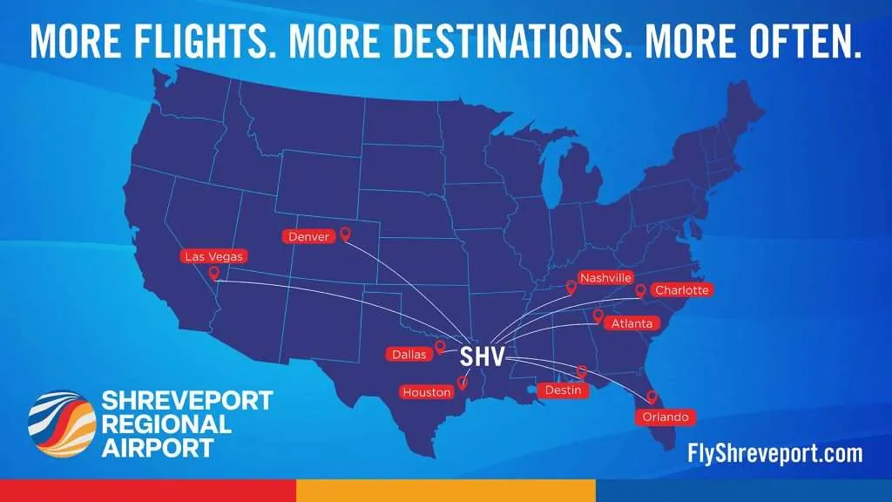
Enplaned versus Deplaned per Year
Year | Enplaned | % Variation | Deplaned | % Variation | Index Enplaned/Deplaned
2022 | 282,716 | 10.7% | 276,468 | 11.1% | 102.3%
2023 | 317,208 | 12.2% | 310,794 | 12.4% | 102.1%
2024 | 362,803 | 14.4% | 347,867 | 11.9% | 104.3%
2025 | 402,831 | 11.0% | 395,658 | 13.7% | 101.8%
Year – Quarter | Enplaned | % Variation | Deplaned | % Variation | Index Enplaned/Deplaned
2024-1 | 74,727 | -10.1% | 73,619 | -10.4% | 101.1%
2024-2 | 94,601 | 26.6% | 89,561 | 21.7% | 105.6%
2024-3 | 95,541 | 1.0% | 88,767 | -0.9% | 107.6%
2024-4 | 97,934 | 2.5% | 95,920 | 8.1% | 102.1%
2025-1 | 86,257 | -11.9% | 84,901 | -11.5% | 101.6%
2025-2 | 111,366 | 29.1% | 107,412 | 26.5% | 103.7%
2025-3 | 109,498 | -1.7% | 108,262 | 0.8% | 101.1%
2025-4 | 95,710 | -12.6% | 95,083 | -12.2% | 100.7%
2026-1 | 78,449 | -18.0% | 76,851 | -19.2% | 102.1%
Data and images from: Shreveport Regional Airport. www.flyshreveport.com
NWLA – ECONOMIC DASHBOARD
Airport Traffic

Slide 62


Enplaning and Deplaning: Shreveport Regional Airport
NWLA – ECONOMIC DASHBOARD
Airport Traffic

Slide 63
Mortgage Rates, Inflation, & Gas Prices

Slide 64
Average 30 Year Mortgage Rate
Year - Quarter | Average 30 YR Mortgage Rate | Year - Quarter | Average 30 YR Mortgage Rate | Year Over Year Change %
2022 Q1 | 3.82 | 2021 Q1 | 2.88 | 32.9%
2022 Q2 | 5.27 | 2021 Q2 | 3.00 | 75.3%
2022 Q3 | 5.62 | 2021 Q3 | 2.86 | 96.6%
2022 Q4 | 6.66 | 2022 Q4 | 3.08 | 116.4%
2023 Q1 | 6.37 | 2022 Q1 | 3.82 | 66.7%
2023 Q2 | 6.51 | 2022 Q2 | 5.27 | 23.6%
2023 Q3 | 7.04 | 2022 Q3 | 5.62 | 25.2%
2023 Q4 | 7.30 | 2022 Q4 | 6.66 | 9.6%
2024 Q1 | 6.75 | 2023 Q1 | 6.37 | 5.9%
2024 Q2 | 7.00 | 2023 Q2 | 6.51 | 7.4%
2024 Q3 | 6.51 | 2023 Q3 | 7.04 | -7.53%
2024 Q4 | 6.63 | 2023 Q4 | 7.30 | -9.2%
2025 Q1 | 6.83 | 2024 Q1 | 6.75 | 1.2%
2025 Q2 | 6.79 | 2024 Q2 | 7.00 | -3.0%
2025 Q3 | 6.57 | 2024 Q3 | 6.51 | 0.9%
2025 Q4 | 6.23 | 2025 Q4 | 6.63 | -6.1%
2025 Q1 | 6.11 | 2025 Q1 | 6.83 | -10.5%
Data from: Federal Reserve Bank of St. Louis. https://fred.stlouisfed.org
NWLA – ECONOMIC DASHBOARD
Mortgage Rates, Inflation, & Gas Prices

Slide 65
Year Over Year Inflation Rate
Year | Month | CPI for All Urban Consumers (CPI-U) | Year Over Year Change %
2024 | Oct | 315.564 | 2.6%
2024 | Nov | 316.449 | 2.7%
2024 | Dec | 317.603 | 2.9%
2025 | Jan | 319.086 | 3.0%
2025 | Feb | 319.775 | 2.8%
2025 | Mar | 319.615 | 2.4%
2025 | Apr | 320.321 | 2.3%
2025 | May | 320.58 | 2.4%
2025 | June | 321.5 | 2.7%
2025 | July | 322.132 | 2.7%
2025 | August | 323.364 | 2.9%
2025 | Sept | 324.368 | 3.0%
2025 | Oct
2025 | Nov | 325.031 | 2.7%
2025 | Dec | 326.03 | 2.7%
2026 | Jan | 326.588 | 2.4%
2026 | Feb | 327.46 | 2.4%
2026 | Mar | 330.293 | 3.3%
Data from: U.S. Bureau of Labor Statistics
NWLA – ECONOMIC DASHBOARD
Mortgage Rates, Inflation, & Gas Prices

Slide 66
Year Over Year Core-Inflation Rate
Year | Month | CPI Value | Year Over Year Change %
2024 | Oct | 321.688 | 3.3%
2024 | Nov | 322.619 | 3.3%
2024 | Dec | 323.296 | 3.2%
2025 | Jan | 324.739 | 3.3%
2025 | Feb | 325.475 | 3.1%
2025 | Mar | 325.659 | 2.8%
2025 | Apr | 326.43 | 2.8%
2025 | May | 326.854 | 2.8%
2025 | June | 327.600 | 2.9%
2025 | July | 328.656 | 3.0%
2025 | August | 329.793 | 3.1%
2025 | Sept | 330.542 | 3.0%
2025 | Oct
2025 | Nov | 331.068 | 2.6%
2025 | Dec | 331.86 | 2.6%
2026 | Jan | 332.793 | 2.5%
2026 | Feb | 333.512 | 2.5%
2026 | Mar | 334.165 | 2.6%
Data from: U.S. Bureau of Labor Statistics
NWLA – ECONOMIC DASHBOARD
Mortgage Rates, Inflation, & Gas Prices

Slide 67
Henry Hub Natural Gas Spot Price (Dollars per Million BTU, Not Seasonally Adjusted)
Year - Quarter | Average Spot Price | Year - Quarter | Average Spot Price | Year Over Year Change %
2023 Q1 | 2.64 | 2022 Q1 | 4.67 | -43.4%
2023 Q2 | 2.16 | 2022 Q2 | 7.50 | -71.2%
2023 Q3 | 2.59 | 2022 Q3 | 8.03 | -67.7%
2023 Q4 | 2.74 | 2022 Q4 | 5.61 | -50.6%
2024 Q1 | 2.15 | 2023 Q1 | 2.64 | -18.7%
2024 Q2 | 2.07 | 2023 Q2 | 2.16 | -4.3%
2024 Q3 | 2.09 | 2023 Q3 | 2.59 | -19.3%
2024 Q4 | 2.44 | 2023 Q4 | 2.74 | -10.8%
2025 Q1 | 4.14 | 2024 Q1 | 2.15 | 93.0%
2025 Q2 | 3.19 | 2024 Q2 | 2.07 | 54.2%
2025 Q3 | 3.03 | 2024 Q3 | 2.09 | 44.9%
2025 Q4 | 3.73 | 2025 Q4 | 2.44 | 52.4%
2026 Q1 | 4.71 | 2025 Q1 | 4.14 | 13.6%
Data from: U.S. Energy Information Administration, Henry Hub Natural Gas Spot Price [DHHNGSP], retrieved from FRED, Federal Reserve Bank of St. Louis; https://fred.stlouisfed.org/series/DHHNGSP
NWLA – ECONOMIC DASHBOARD
Mortgage Rates, Inflation, & Gas Prices

Slide 68
Crude Oil Prices: West Texas Intermediate (WTI) - Cushing, Oklahoma
Year - Quarter | Average Crude Oil Prices | Year - Quarter | Average Crude Oil Prices | Year Over Year Change %
2023 Q1 | 75.93 | 2022 Q1 | 95.18 | -20.2%
2023 Q2 | 73.59 | 2022 Q2 | 108.83 | -32.4%
2023 Q3 | 82.07 | 2022 Q3 | 93.06 | -11.8%
2023 Q4 | 78.53 | 2022 Q4 | 87.55 | -10.3%
2024 Q1 | 77.50 | 2023 Q1 | 75.93 | 2.1%
2024 Q2 | 81.81 | 2023 Q2 | 73.59 | 11.3%
2024 Q3 | 76.43 | 2023 Q3 | 82.07 | -6.9%
2024 Q4 | 70.73 | 2023 Q4 | 78.53 | -9.9%
2025 Q1 | 71.78 | 2024 Q1 | 77.50 | -7.4%
2025 Q2 | 64.57 | 2024 Q2 | 81.81 | -21.1%
2025 Q3 | 65.78 | 2024 Q3 | 76.43 | -13.9%
2025 Q4 | 59.62 | 2025 Q4 | 70.73 | -15.7%
2026 Q1 | 72.74 | 2025 Q1 | 71.78 | 1.3%
Data from: U.S. Energy Information Administration, Crude Oil Prices: West Texas Intermediate (WTI) - Cushing, Oklahoma [DCOILWTICO], retrieved from FRED, Federal Reserve Bank of St. Louis; https://fred.stlouisfed.org/series/DCOILWTICO
NWLA – ECONOMIC DASHBOARD
Mortgage Rates, Inflation, & Gas Prices

Slide 69
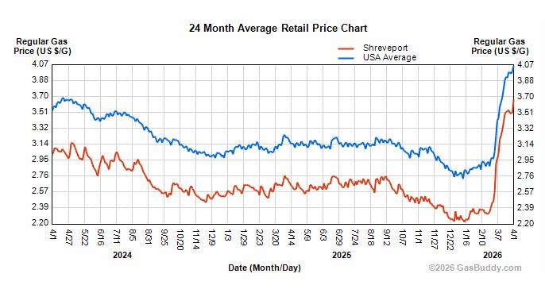
Gas Prices – April 1, 2026
Data from: GasBuddy
NWLA – ECONOMIC DASHBOARD
Mortgage Rates, Inflation, & Gas Prices

Slide 70
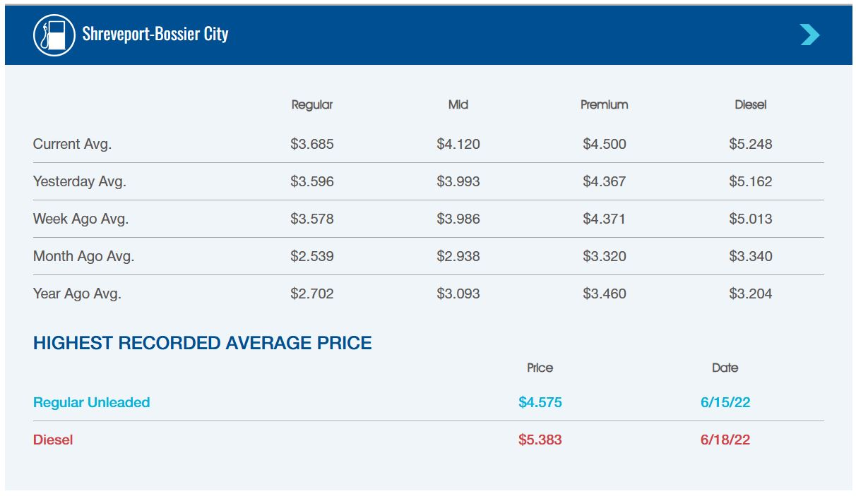
Gas Prices – April 1, 2026
Data from: AAA
NWLA – ECONOMIC DASHBOARD
Mortgage Rates, Inflation, & Gas Prices

Slide 71
Thank you!
Douglas White
Director, Center for Business & Economic Research
Louisiana State University, Shreveport
douglas.white@lsus.edu

